Slide 1

Introduction to Programming using MySQL
Lesson 8 :MySQL, Query, Table
Workshop Leader: Narek Sukiasyan

Slide 2
What is MySQL
MySQL is open-source relational database management system or RDBMS
MySQL is a database system used on the web
MySQL is a database system that runs on a server
MySQL is very fast, reliable and easy to use
MySQL supports standard SQL or (Structured Query Language)

Slide 3
How MySQL is work
The data in MySQL is stored in tables
A table is a collection of related data and it consists of colums and rows
Remember` Database are useful when storing information categorically.
For example a social network may have a database with the following tables
Users
Personal Information
Messages
Articles
Posts
Friends …

Slide 4
Database Tables
A database most of contains one or more tables
Each table is identified by a name, (for example users)
Tables contain records (rows) with data.
ID | Username | Password | Joined | Status
1 | aram.aramyan | d5g4dfgd4fg9dfg54dfgdf | 2014/08/10 | active
2 | poxos.poxosyan | 45v39874d6f5gd9fg4dfg | 2012/12/05 | freeze
3 | petros.petrosyan | d4d5f4g98df7g6df4gdf4g | 2013/10/10 | active
4 | anahit1980 | df4g98dfg65df4g6d4f4dfsdf | 2009/10/13 | active

Slide 5
What is SQL commands or Query
ID | Username | Password | Joined | Status
1 | aram.aramyan | d5g4dfgd4fg9dfg54dfgdf | 2014/08/10 | active
2 | poxos.poxosyan | 45v39874d6f5gd9fg4dfg | 2012/12/05 | freeze
3 | petros.petrosyan | d4d5f4g98df7g6df4gdf4g | 2013/10/10 | active
4 | anahit1980 | df4g98dfg65df4g6d4f4dfsdf | 2009/10/13 | active
SELECT
*
FROM
users;

Slide 6
Some of The Most Important SQL Commands
SELECT
extracts data from a database
UPDATE
updates data in a database
DELETE
deletes data from a database
INSERT INTO
CREATE DATABASE
ALTER DATABASE
DROP TABLE
CREATE TABLE
inserts new data into a database
creates a new database
modifies a database
creates a new table
deletes a table

Slide 7
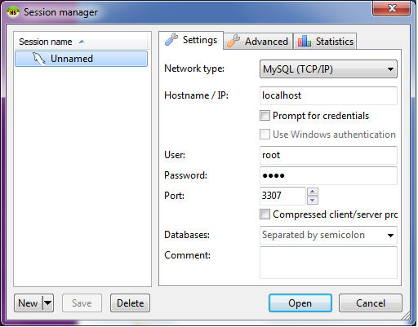
Lets start to work with MySQL
Hostname/IP -> localhost
User -> root
Password -> usbw
Port -> 3307

Slide 8
How create new table for users
ID | Username | Password | Joined | Status
USE `database name`;
This query tells the MySQL server to use your database for the rest of the session
USE `test`;

Slide 9
How create new table for users
id | username | password | status
CREATE TABLE name(
column name parametrs,
column name parametrs
);

Slide 10
How create new table for users
id | username | password | status
CREATE TABLE name(
id INT AUTO_INCREMENT NOT NULL,
username VARCHAR(200) NOT NULL,
password VARCHAR(2000) NOT NULL,
status VARCHAR(10) NOT NULL,
PRIMARY KEY(id)
);

Slide 11
How select information from table
id | username | password | status
SELECT * FROM users;
This query tells the MySQL server to select all columns from users table
SELECT username, password FROM users;
This query tells the MySQL server to select only username and password columns
from users table

Slide 12
How insert data to table in MySQL
id | username | password | status
INSERT INTO tablename () VALUES();
This query tells the MySQL server to select all columns from users table
SELECT username, password FROM users;
This query tells the MySQL server to select only username and password columns
from users table

Slide 13
How insert data to table in MySQL
id | username | password | status
INSERT INTO users(username, password, status)
VALUES (‘poxos1980’, ‘helloworld’, ‘active’);

Slide 14
Lets not Select information from users
id | username | password | status
SELECT * FROM users;
This query tells the MySQL server to select all columns from users table
SELECT username, password FROM users;
This query tells the MySQL server to select only username and password columns
from users table

Slide 15
Lets not Select information from users
id | username | password | status
SELECT * FROM users WHERE id = 5;
The WHERE clause is used to extract only those records that fulfill a specified criterion.

Slide 16
Where()
Starting selecting data from database
Select from users table
SELECT username, password FROM users WHERE id = 5;
Select only data where id = 5
Select only username and password columns

